Slide 1
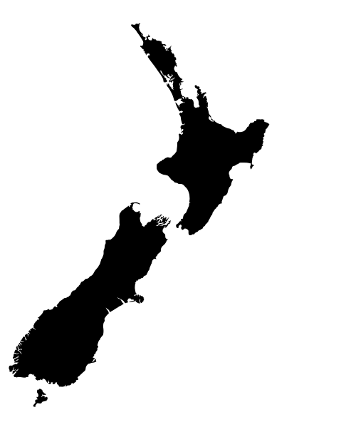
New Zealand’s Domestic Coordination Mechanisms for Technical Barriers to Trade

Slide 2
Outline
New Zealand context
TBT Strategy
A User Guide for Regulators
Promotional workshops

Slide 3
New Zealand Context
Population: 4.9 million
Core public service employees: 50,000
Public service policy employees: 2,700
New Zealand’s regulatory system
meeting regulatory objectives in a least cost way
focus on performance-based regulation and recognition of global standards and certification systems
a small country with small-sized regulatory agencies.

Slide 4
New Zealand Context - TBT
it is a challenge to keep TBT obligations front of mind, especially for small regulators
most regulators only develop regulations or standards within scope of the TBT Agreement every few years
we do not have a formal coordination structure for TBT, such as a national committee
we rely on our WTO TBT Enquiry Point to lead stakeholder outreach
our Ministry for Primary Industries is our most active regulator on TBT issues

Slide 5
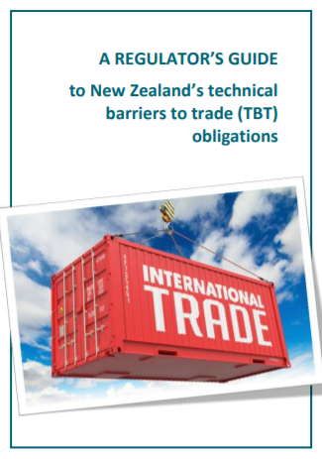
TBT User Guide
targeted at regulatory agencies
designed to assist regulatory agencies in New Zealand with meeting international TBT obligations (including WTO and FTA obligations)
an educational tool for regulators to help if they are not developing regulations frequently
circulated to agencies and published online

Slide 6
TBT User Guide - content
introduction to technical regulations, standards and conformity assessment procedures
background information on the WTO Agreement on TBT (based on WTO materials)
outline of WTO TBT obligations
outline of New Zealand’s TBT obligations in our regional trade agreements
a step-by-step guide for incorporating WTO obligations into a regulatory development process.

Slide 7
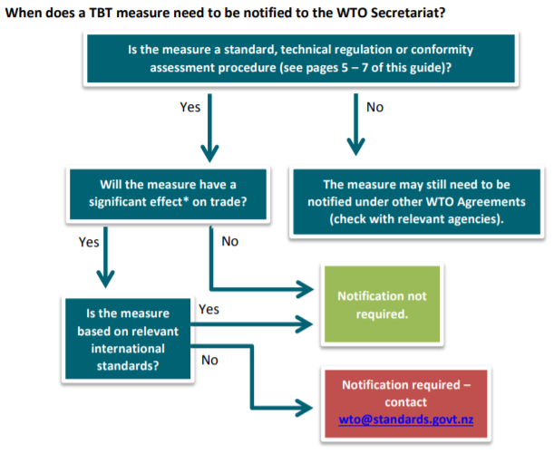
TBT User Guide - notifications

Slide 8
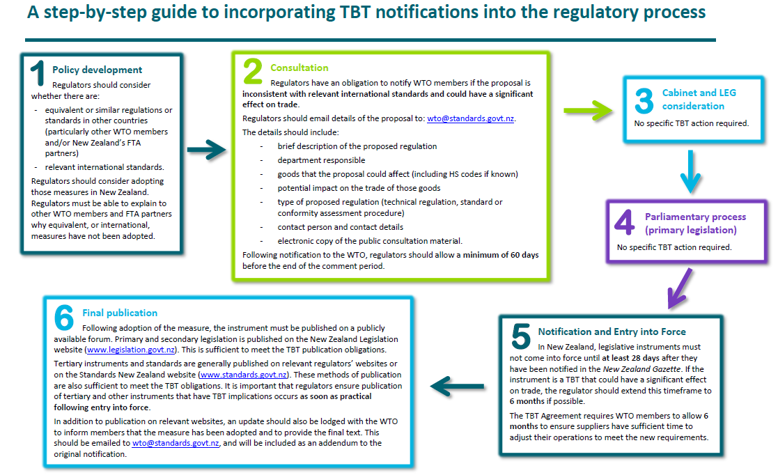
TBT User Guide – step-by-step

Slide 9
Workshops for regulators
Workshops for regulatory agencies run by Standards New Zealand and TBT policy officials
Workshops provide guidance on:
WTO TBT Agreement and scope
international obligations
avoiding unnecessary obstacles to trade
the notification process
transparency best practice
content of the User Guide

Slide 10
The New Zealand Gazette - a backstop
The New Zealand Gazette is the official newspaper of the New Zealand government
contains official commercial and government notifications
notices are published online continuously and are freely available to the public
Our National Enquiry Point monitors the New Zealand Gazette to ensure that all technical regulations and conformity assessment procedures are notified to WTO members.

Slide 11
Thank you
Website: www.standards.govt.nz/international-engagement/technical-barriers-to-trade/
For more information, please contact:
Trade and International Team
Ministry of Business, Innovation and Employment email: tradebarriers@mbie.govt.nz

